Slide 1
HOW DOES POVERTY IMPACT THE INDIAN ECONOMY ?
NAME: DEBASMITA SAHA
CLASS ROLL NO.: ECON045
REGISTRATION NO.: 21201220045
PAPER NAME: INDIAN ECONOMY I
PAPER CODE: ECON05C11

Slide 2
CONTENTS
ABSTRACT
INTRODUCTION
POVERTY IN INDIA
LITERATURE REVIEW
METHODOLOGY AND FINDINGS
POVERTY ALLEVIATION PROGRAMMES DURING THE PLAN PERIODS
CASE STUDY: “FARMERS’ SUICIDES IN INDIA”
CONCLUSION
REFERENCES

Slide 3
ABSTRACT
This presentation attempts to provide an overview of the understanding of poverty in India and to suggest future research directions.
We had shown how poverty has impacted the income inequality sector, employment sector and education sector for different states in India over the years from 1951-2020.
Additionally, the statistical data of a case study on farmers’ suicide has also been presented to get a clear data on the poverty rate in India.

Slide 4
INTRODUCTION
Poverty has been defined as a state of "pronounced deprivation in well-being", while being poor is defined as "to be hungry, to lack shelter and clothing, to be sick and not looked after, to be illiterate and been uncivilized".
Rural poverty poses the most serious concern to policy makers and public analysts in India.
The central issues are, “Does overall economic growth reduce poverty, i.e., is there a "trickle-down" mechanism?” and “Has economic growth been accompanied by rising income inequality?”

Slide 5
POVERTY IN INDIA
India is ranked 162 Gross National Income (GNI) per capita with 1410 US Bones in 2011 and is named as ‘lower middle income country’ and is ranked 156 under Purchasing Power equality (PPP) system a GNI per capita of 3590 transnational bones in 2011.
In 2010, The World Bank reported that 32.7 of the total Indian people falls below the transnational poverty line of US$1.25 per day while 68.7 live on lower than US $2 per day.
Poverty in India is substantially due to lack of proper government programs and the exploitation of the financially weaker section by the richer class.
Poverty Line is the cut-off position of per capita consumption expenditure per month which is demanded to maintain minimal respectable standard of living in a country. Poverty lines are sometimes described as ‘starvation lines’.

Slide 6
LITERATURE REVIEW
According to Sahasranaman et al., (2021), he suggested that transitions out of poverty outweighs transitions into poverty in recent times, but that there is still a non-trivial proportion of individuals changing annually into poverty, highlighting the economic weakness of those near the poverty line.
According to Mehta A., Shah A. (2001), he showed an overview of incidence of income poverty in India to put chronic poverty in place.
Bhalla et al. (2022) highlight that including food subsidies in measures of consumption estimates was important in understanding the extent to which India may have helped mitigate extreme poverty during the pandemic.
According to Mujawar J. (2017), he compared the relation between education and poverty at both macro and micro levels.

Slide 7
METHODOLOGY AND FINDINGS
Here, we are mainly looking into how poverty is impacting the three main sectors of the Indian economy namely, the income inequality sector, the education sector and the employment sector for different states in India.

Slide 8
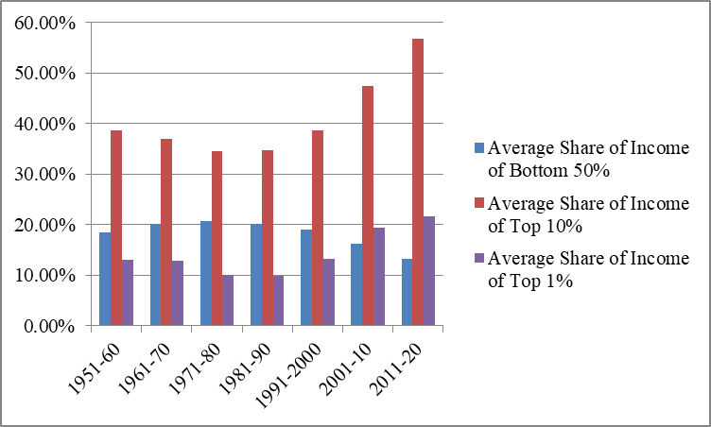
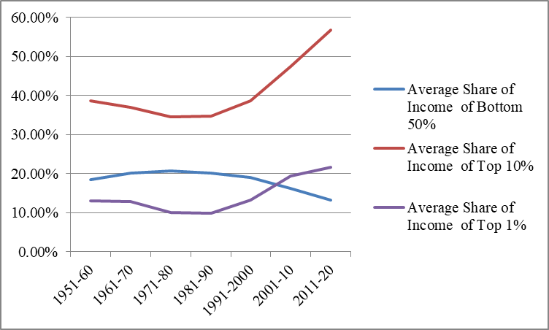
1. Income Inequality-Poverty Relationship:

Slide 9
Findings:
The graph showed that the average income share of the bottom 50% rose from 1951-60 till 1991-2000. After then, it witnessed a decline in its trend from 2001-20.
The Top 10% had a quite upward trend throughout from 1951-2020.
The top 1% also had an upward trend but less than top 10% .

Slide 10
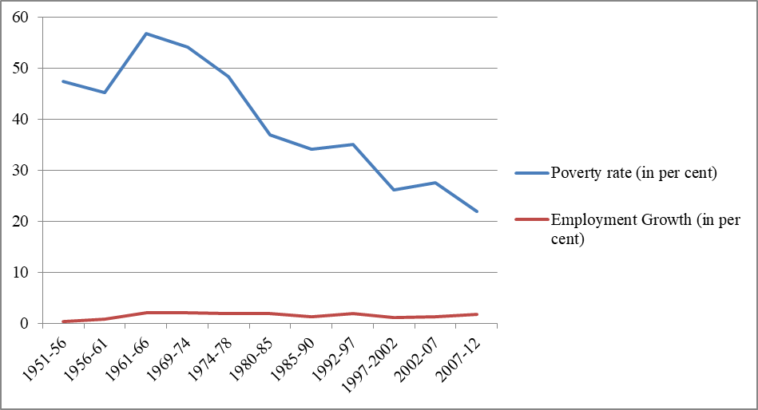
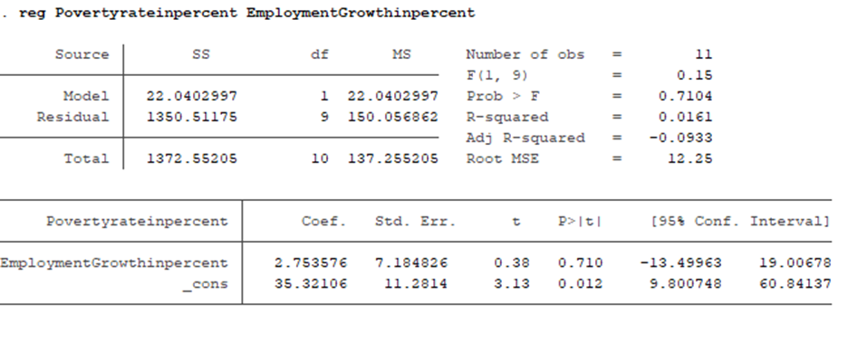
2. Employment-Poverty Relationship:

Slide 11
Findings:
A higher rate of decline in the poverty rate over the years from 1951 to 2012 indicated by a downward sloping curve on the graph, whereas the employment growth remained almost the same (constant) throughout the time period.
There is no significant presence of unemployment on that time period; maybe there was frictional or structural unemployment for shorter periods over the years.
From the stata output, we get to see that, as employment growth increases by 1 per cent, poverty rate increases by 2.75 per cent throughout from 1951-2012.

Slide 12
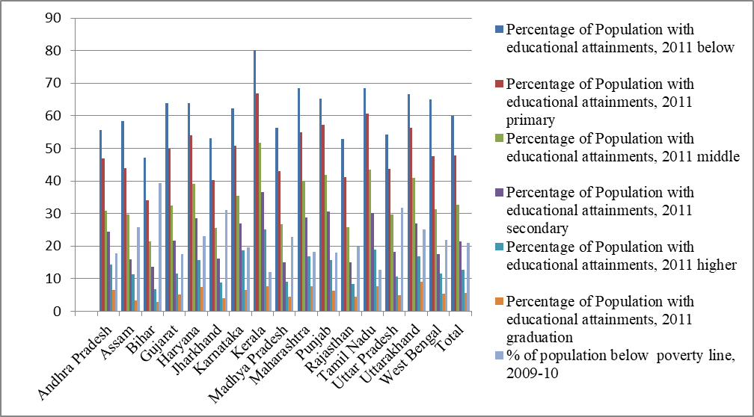
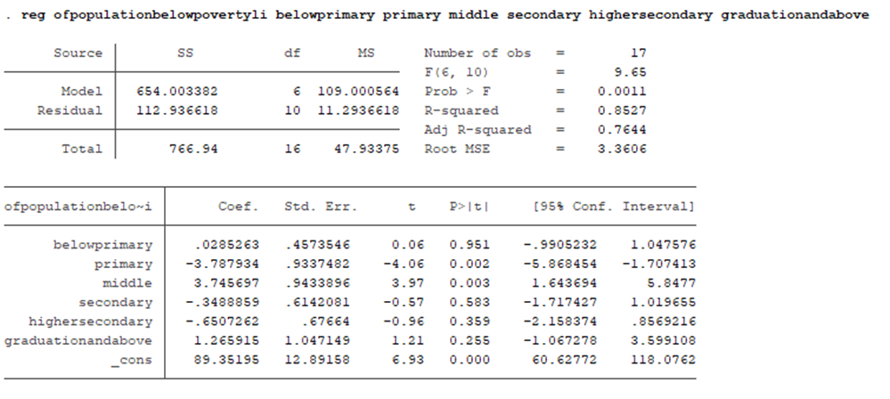
3. Education-Poverty Relationship:

Slide 13
Findings:
Here, ‘below primary’ educational level is the highest among all other educational levels for all the states of India in 2011.
People who are ‘graduated and above’ are having the least records for all the states.
As poverty rate increases, more people are remaining uneducated. Overall, we notice there is a negative trend between education and poverty in India in 2011.

Slide 14
POVERTY ALLEVIATION PROGRAMMES DURING THE PLAN PERIODS
Some of the poverty alleviation programmes can be summed up as follows,
Small Farmers Development Agency (SFDA)
Drought Prone Areas Programme (DPAP)
Minimum Needs Programme (MNP)
Training of Rural Youth for Self-employment (TRYSEM)
National Rural Employment Programme (NREP)
Employment Assurance Scheme (EAS)

Slide 15
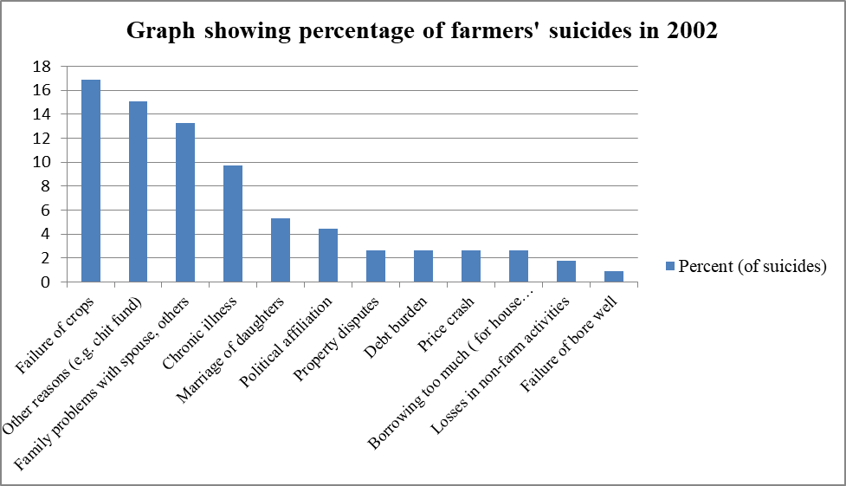
FARMERS’ SUICIDES IN INDIA
Farmer suicides account for11.2 of all self-murders in India.
The National Crime Records Bureau of India reported that an aggregate of 296,438 Indian growers had failed by self-murder between 1995 and 2014.
The planter's self-murder rate in India had ranged between1.4 and1.8 per 100,000 of total population, over a 10- time period through 2005.

Slide 16
FINDINGS:
Financial instability is a significant driver of farmer suicides.
Farmers are highly dependent on weather conditions for successful crop production.

Slide 17
CONCLUSION
Poverty in India remains a complex issue closely tied to inequality. The COVID-19 pandemic has had a significant and complex impact on poverty in India.
Employment plays a central role in the poverty landscape of India.
Education is a critical determinant of poverty in India.

Slide 18
REFERENCES
Sahasranaman et al., (2021). Long-term dynamics of poverty transitions in India.
Pal M., Bharati P. (2005). Development of Methodology towards Measurement of Poverty (Project sponsored by Ministry of Statistics and Programme Implementation).
Mujawar J Mujawar J. (2017). Relationship between Education and Poverty: A Case of India.
Mehta A, Shah A, Chronic Poverty Research Centre (2001). Chronic poverty in India : overview study.
Bhalla SBhasin KVirmani A.(2022). Pandemic, Poverty, and Inequality: Evidence from India, WP/22/69, April 2022.
Arbatli-Saxegaard ECoppo MKhalil NKotera SFiliz D (2023). Inequality and Poverty in India: Impact of COVID-19 Pandemic and Policy Response, WP/23/147, July 2023.
Dhamija N., Bhide S. (2010). Dynamics of Poverty in India: A Panel Data Analysis.
Deaton A, Dreze J. (2002). Poverty and Inequality in India: A Re-examination.
Banerjee A, Mazumdar D. (2016). Principles of Economics.

